Slide 1
Texas A&M - Kingsville
Educator Preparation Program
ITSE Standards for Educators
ITSE Standards

Slide 2
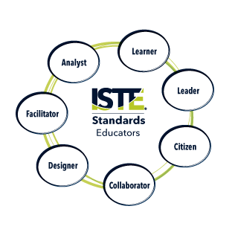

Slide 3
Q1. Describe Activities offered by your program that are designed to prepare teachers to “integrate technology effectively into the curricula and instruction”

Slide 4
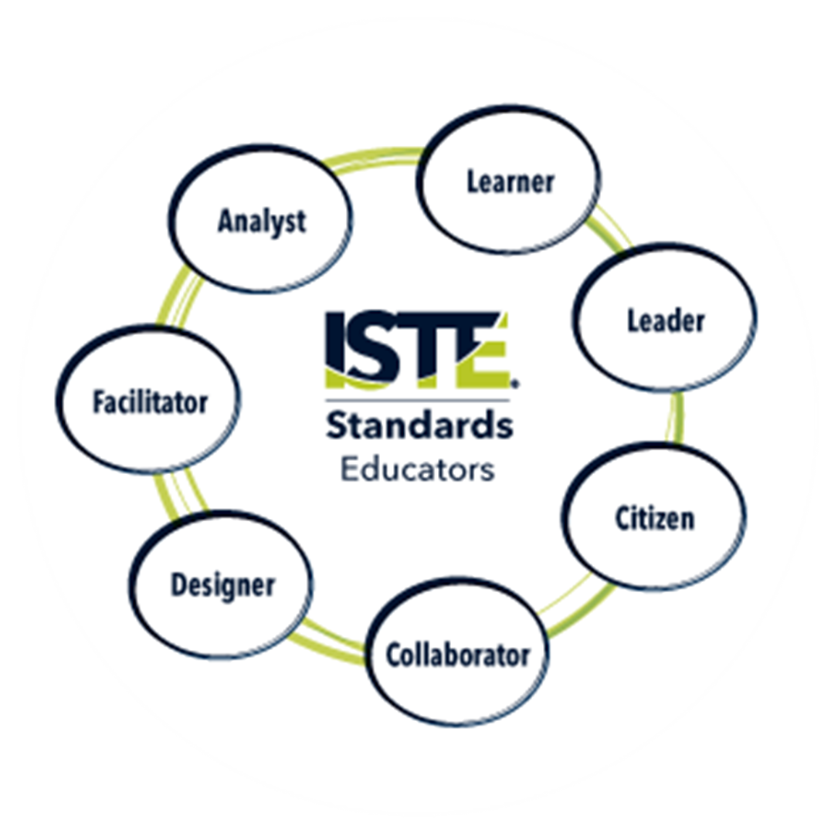
Activities Integrated into curricula and instruction
Use of university research commons / interactive learning spaces classroom
Instructional activities:
SWBAT:
select a technology tool to be implemented into a lesson plan that will be used in their future classroom;
Design (ITSE Standard 1) the lesson
Collaborate with group
Demonstrate the lesson (ITSE Standard – Collaborator)

Slide 5
Q2. Describe the activities offered by your program that are designed to prepare teachers to “use technology effectively to collect, manage, and analyze data to improve teaching and learning for the purpose of increasing academic achievement.”
ITSE Standards

Slide 6
Activities Offered by our program that are designed to prepare teachers to “use technology effectively to collect, manage, and analyze data to improve teaching and learning”
SWBAT:
Record reading activities (eg. Read-alouds)
Upload recording to platform for dissemination for classroom purposes
Utilize SmartBoard Technology to create lesson plans

Slide 7
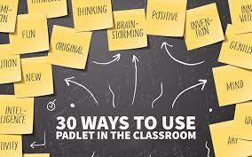
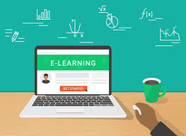
Students will be able to utilize technology Applications and activities in developing and delivering lessons:
Google Docs
Quizlet
Padlets
Kahoot
Online Learning Apps
EDpuzzle

