Slide 1
Student Advising Presentation
Updated Spring 2017
Breanna Bailey, Associate Dean, COE

Slide 2
Why Pre-Advising?
Advisors make mistakes. Students make mistakes. Policies change.
The more informed you are about graduation requirements, the less likely you are to experience a graduation delay due to a mistake or policy change.
Ultimately, making sure you graduate is your responsibility!

Slide 3
Presentation Overview
Generals Notes and Policy Changes.
Getting Advised.
Frequently Asked Questions.
Other Useful Information.

Slide 4
General Notes and Policy Changes
What degree plan are you following?
Talk to your advisor!
Specify with a Change of Curriculum Form.
Current catalog was published Fall 2016.
Catalogs will now be published every fall to better reflect curricular changes.

Slide 5
General Notes and Policy Changes
Entered TAMUK before Fall 2012 and thinking about changing catalogs?
Important Fall 2012 change:
Writing Intensive (WI) Course required.
Must earn a C or higher in one WI course.
Important Fall 2014 changes:
General education requirements changed.
New GPAs for graduation: 2.0 overall, 2.25 math/science, 2.25 engineering.

Slide 6
General Notes and Policy Changes
Check for new academic policies: http://www.tamuk.edu/registrar/
Drop policy:
Automatic Q if drop by March 31st – 5 pm.
Cannot drop or withdraw after this date.
Advisor’s signature required.

Slide 7
General Notes and Policy Changes
“Excluded” hours = original course grade is removed from GPA calculation.
Excluded hours policy:
One chance to replace your first grade earned in a course with the second grade earned in the course.
Third (or higher) grades earned in a course averaged into your GPA calculation.

Slide 8
General Notes and Policy Changes
Example 1:
MATH 2413 – Attempt #1 – F
MATH 2413 – Attempt #2 – A
GPA for MATH 2413 = 4.0.

Slide 9
General Notes and Policy Changes
Example 2:
MATH 2413 – Attempt #1 – F
MATH 2413 – Attempt #2 – F
MATH 2413 – Attempt #3 – A
GPA for MATH 2413 = (4*0 + 4*4) / 8 = 2.0
1st grade of F replaced by 2nd grade of F, which is then averaged with 3rd grade of A.

Slide 10
General Notes and Policy Changes
Many courses are offered only once a year. Be sure you are paying attention to prerequisites!
Prerequisite = Courses you must take before enrolling.
Corequisite = Courses you must take concurrently or already have credit in.
Senior design is (usually) a year-long project. Teams are formed in the fall and complete work in the spring. Courses must be taken in sequence.

Slide 11
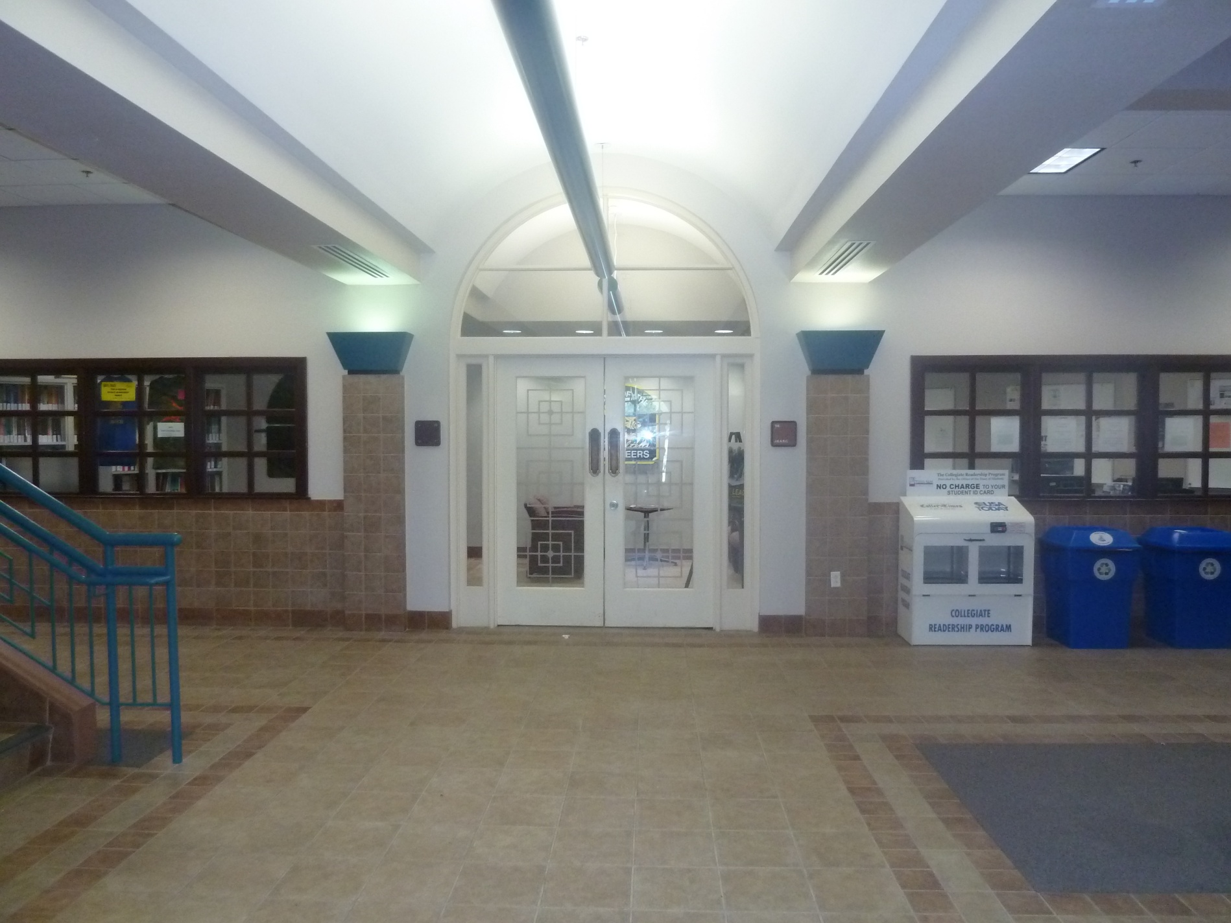
Getting Advised
New students are advised in the Javelina Engineering Student Success Center (JESSC).
Freshmen up to 30 hours.
Transfer students in their first semester.
Sophomores and returning transfer students see departmental faculty advisors.

Slide 12
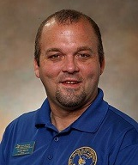
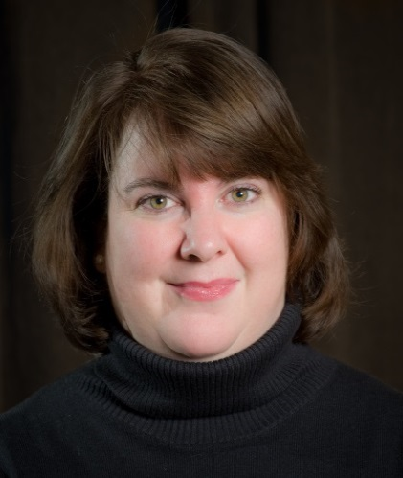
Getting Advised: JESSC Professionals
Austin McCoy
Director, JESSC
Degree checkout!
Professional Academic Advisors
Margaret Hennesey
CHEN, NGEN, MEEN
Tony Ramirez
AEEN, CEEN, CSEN, EEEN, EVEN, MTEN
Sasha Diaz
APEN

Slide 13
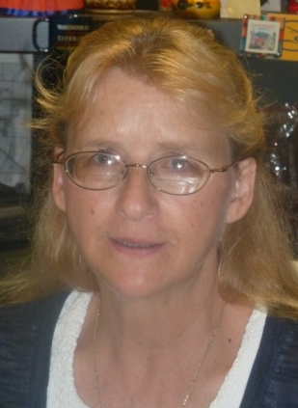
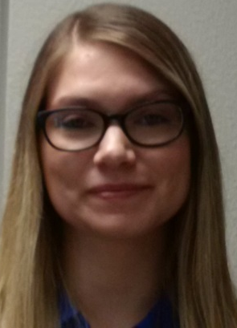
Getting Advised: Department Admins
Position
Vacant
Cathey
EVEN
Beth
MEEN
CEEN & AEEN
Ms. Cathey will assist!
Position
Vacant
Dalia & Debra
EEEN & CSEN
CHEN & NGEN
Ms. Beth will assist!
Jessica
MTEN

Slide 14
Getting Advised: Department Chairs
Dr. Sai
CEEN & AEEN
Dr. Clapp
EVEN
Dr. Peel
MEEN
Dr. Challoo
EEEN & CSEN
Dr. Mills
CHEN & NGEN
Dr. Heidari
MTEN

Slide 15
Getting Advised
Your departmental administrative associate can…
Help you find your faculty advisor.
Provide you with your student file and other advising documents.
Lift your advising hold.
Resolve registration errors / problems.
Questions or concerns about advising? Resources include:
Faculty or professional advisors.
Departmental chairs and administrative associates.
JESSC Director.

Slide 16
Getting Advised
Advising Checklist
Make an appointment with your advisor.
Bring to your appointment your...
Student file
Advising form
Current copy of your academic transcript (unofficial OK).
Review your degree plan ahead of time.
Return your file and completed advising form to your departmental admin to get your hold lifted.
Register for the classes you discussed with your advisor.
Remember to ask questions! You are in charge of making sure you are on track for graduation!

Slide 17
FAQ
I failed a class, but it is a prerequisite for a second class that I must take this semester or my graduation will be delayed. Can’t I take the second class anyway?
No. Prerequisites should not be treated as suggestions. Take the time to get the preparatory material right.
Can I retake a class to improve my grade?
Yes, but remember the course will only be excluded in one GPA calculation. Also, if you fail the class, you lose the credit for course!
Can I drop a class I’m retaking if I’m doing badly?
Yes! Standard drop procedures apply.

Slide 18
FAQ
When is the Q drop deadline?
Spring 2017 – March 31
Fall 2016 – November 1
An add/drop form must be submitted to the registrar’s office with your advisor’s signature. You will receive a “Q.”
How do I drop a class after the Q drop deadline?
You can’t.
Can I still get an incomplete?
An incomplete is given for family or personal emergencies only. There must be a justification for the incomplete that goes beyond poor student performance.

Slide 19
FAQ
I got a “D” in a required course. Does it count?
Yes, as long as it was earned at TAMUK. “D” grades in math, science, and engineering cannot be transferred from other institutions. You may need to retake a TAMUK “D” if:
1) It is earned in a Writing Intensive Course.
2) It puts you below the minimum GPAs for graduation.
What is a Writing Intensive Class?
Writing Intensive (WI) classes require you to complete approximately 10 single-spaced pages of writing (individually) over the course of the semester. They are a junior or senior level course, usually in your major– ie, senior design. You must earn a “C” in at least one WI course to graduate (Fall 2012 or later degree plans). May take WI outside your major.

Slide 20
FAQ
What are the minimum GPAs for graduation?
Catalogs before 2014:
2.0 cumulative, 2.0 engineering, 2.0 math/science
2014 or later catalogs:
2.0 cumulative, 2.25 engineering, 2.25 math/science
Industrial Technology Majors:
2.0 cumulative, 2.50 in major, 2.25 in math/science,
2.25 in business

Slide 21
FAQ
What do I do if there’s an error on my transcript?
Contact the registrar’s office. The earlier the better.
I completed a substitution form. Why doesn’t it show up on my transcript?
Substitution forms are internal to the College of Engineering and will not show up on your transcript.
I completed a substitution form. Why doesn’t it show up on DegreeWorks?
See above. Substitutions must be “forced” into DegreeWorks, and the updating process is slow.

Slide 22
FAQ
Why does my …(fill in the blank)… not agree with DegreeWorks?
DegreeWorks is imperfectly implemented. If you find an error, please inform Mr. McCoy AND your department chair. The Registrar’s office is working with the COE to identify and correct errors.
Are your major and catalog year up-to-date with the Registrar’s office? DegreeWorks reflects only what has been coded by the Registrar’s office, and change of curriculum forms take a semester to process.

Slide 23
FAQ
How do I change my major?
If you’re changing within the COE, there’s a “Change of Curriculum” form (see departmental admin) to be signed by the chair of your new department. Attach a transcript. Most departments want to see a 2.5 GPA.
How do I get out of PPEN / APEN and into my “real” major?
Complete the “Change of Curriculum” form. You must have completed chemistry and analytical geometry or higher and have 2. 0 cumulative and math/science GPAs.
What if my GPA is not high enough to transfer into the major I want?
Make an appointment with your department chair to discuss your individual situation and your options.

Slide 24
FAQ
How do I declare a minor?
Complete the “Change of Curriculum” form. At graduation, make sure your advisor lists completes the minor check out form in your graduation packet.
What are the requirements for a minor?
You need 18 hours in a program closely aligned with your major. At least 6 hours must be upper level courses.
Some programs (ie, Business Administration) have specific requirements for a minor. Be sure to consult an advisor in the college where you hope to earn a minor– in addition to your College of Engineering advisor.

Slide 25
FAQ
What are the requirements to double major?
You must complete all required courses for both majors plus a minimum of 24 hours unique to the second degree.
Can I change my degree plan?
Your initial degree plan will refer to the undergraduate catalog in effect when you first attended TAMUK (unless absent for two or more semesters). If your degree plan changes during your time at TAMUK, you may opt to follow the new degree plan. Discuss your options with your advisor and complete a “Change of Curriculum” form.
Remember – DegreeWorks will only show the catalog and major to which you were admitted UNLESS you complete a Change of Curriculum Form.

Slide 26
FAQ
What is scholastic probation?
You will be placed on scholastic probation if your cumulative GPA drops below 2.0 in a given semester. You have one semester to raise your GPA above 2.0 or you will be placed on enforced withdrawal.
What is enforced withdrawal?
Enforced withdrawal occurs when your cumulative GPA falls below 2.0 for two consecutive long (fall/spring) semesters. Enforced withdrawal means you are not allowed to register at TAMUK in the next long semester. Processes for appealing enforced withdrawal are getting stricter.

Slide 27
FAQ
What are my options if I am on enforced withdrawal (EW)?
If placed on EW at the end of the Spring semester, enroll in Summer classes to raise your GPA. Retake classes with Fs or Ds if possible.
Complete a “Readmission Request” (also called Enforced Withdrawal Appeal” form. This process starts with your advisor and a written statement.
Sit out for one or two semesters. When you return to TAMUK, your advisor can email the registrar to request your reinstatement.

Slide 28
FAQ
What is the “check out” procedure for graduation?
New process beginning Summer 2017! Stay tuned!
Complete the graduation application online through Blue and Gold.
Pick up a graduation packet from the JESSC.
Make an appointment with your advisor to complete the packet and a final degree plan.
Order an official transcript.
See your advisor and department chair for signatures on the completed packet.
Return the packet, degree plan, transcript to the JESSC.

Slide 29
FAQ
When is the degree packet due?
Academic calendar lists: “Deadline to file Application for Degree Candidacy... with Academic College Dean.”
Due the semester before graduation, on the first of May, August, or December.
What happens after I submit my degree packet?
Watch for emails from the JESSC Director about any incomplete paperwork and from the Provost office with details about graduation. Don’t forget to sign up at the bookstore for your cap and gown and participate in Senior Reception!

Slide 30
Other Useful Information
Check your students email frequently!
TAMUK offices are only allowed to send updates / information to your students email, including:
Graduation information
Financial aid information
Drops for non-payment
Drops for non-attendance
Drops for lab safety training

Slide 31
Other Useful Information
TAMUK does not receive formula funding for students taking more than 30 hours above degree plan (State law, THECB)
Students will be charged $100/hr for each hour beyond B.S. + 30.
Earning a second bachelor's degree will help. Minors, associates degrees, and certificates do not.
Tuition rebate available to students completing in 4 years, without excess hours, 15 hours a semester.

Slide 32
Other Useful Information
Financial aid implications of dropping a class
You must attend 60% of class or repay financial aid.
You must repay financial aid if you do not earn at least 67% of attempted hours for a semester.
You may stay on financial aid if you drop below 12 hours after the census date (12th class day).
See your financial aid advisor!
Tutoring available in the JESSC
Math, science, and basic engineering courses
By upper-level engineering students
For discipline-specific help, let JESSC know!

Slide 33
Other Useful Information
Offices serving students:
Student Health and Wellness (http://www.tamuk.edu/shw/index.html)
Career Services (http://www.tamuk.edu/csc/)
Academic Testing Center (http://www.tamuk.edu/academictesting/)
Student handbook:
http://www.tamuk.edu/dean/dean_files/studenthandbook.pdf

Slide 34
Questions?
Please be sure to sign in if attending a pre-advising session in person. If reviewing online, complete the worksheet and submit to your professional advisor or departmental administrative associate.

