Slide 1
2014 Summer Training
Budget & Canopy Reports

Slide 2
Budget
“We must consult our means rather than our wishes.”
― George Washington
"A billion here, a billion there—sooner or later it adds up to real money."
— Senator Everett Dirksen

Slide 3
What is a Budget?
Financial Planning can be short or long-term
A budget is for one year and is the main building block of a long-term financial plan
Should answer four questions:
  How much money do we have to spend?
  Where did we get the money?
  What do we plan to do with it?
  Why do we plan to spend it in the way we are proposing?
A financial budget is a plan, not a reality.
A budget is dynamic and always changing. Allow room for change.

Slide 4

Some of the bags that we need to fill…
Instruction
Support Services
  Accounting
  Purchasing
  Campus Police & Safety
  Physical Plant-Maintenance
Student Service
  Student Affairs
  Admissions & Records
  Financial Aid
  Academic Advising
  Life Services & Wellness
Athletics
Auxiliary Services
  Food Services
  Bookstore
  Campus Housing

Slide 5
Budgeted Account
Revenue Source
Actual Expenditures
Encumbrances: (Ls, Rs, Ps)
Reserves

Slide 6
Revenue budget
Total Revenue $154,042 (in thousands)

Slide 7
Expenditure budget
Total Expenses $129,372 (in thousands)

Slide 8
What happens to my account balance at year end?
Account Range:
  (100000 - 160299) Budget closes to University E&G Reserve account
  (160300 – 160349) RDF funded every two years, must be used up by end of second year
  (160900 – 160999) HEF funding, balance rolls to new year for the life of the project
  (170000 – 199999) Budget closes to University E&G Reserve account
  (200001 – 216000) Self Supporting Accounts, available balance will roll forward at year end
  (216100 – 216299) University Service Fee, available balance will close to USF reserve
  (216550 – 216559) Group Hospital Fee, available balance will close to hospital fee reserve
  (216600 – 216609) Applied Music Fee, available balance will close to Music fee reserve
  (216000 – 216809) Application Fee, available balance will close to Application fee reserve
  (218000 – 218499) Designated Tuition, available balance will close to University’s DT Reserve Account

Slide 9
What happens to my account balance at year end? - Continued
Account Range:
  (310000 – 319999) Student Service Fee, available balance will close to SSF Reserve
  (314000 – 314999) Rec Sports Fee, available balance will close to Rec Sports fee Reserve
  (315000 – 315999) Athletic Fee, available balance will close to Athletic fee reserve
  (317000 – 317009) Parking Fee, available balance will close to UPD reserves
  (320000 – 329990) Self Supporting Accounts, available balance will roll forward at year end
  (332000 – 349999) Dorms & SUB, available balance will close to the appropriate Dorm or SUB reserve account
  (870000 – 879999) HEF funded construction projects, balance available for the life of the project, then closed to a University HEF reserve
  (880000 – 889999) Non-HEF funded construction projects, balance available for the life of the project, then reverts to source
  This info can be found on the Attributes screen in Canopy

Slide 10
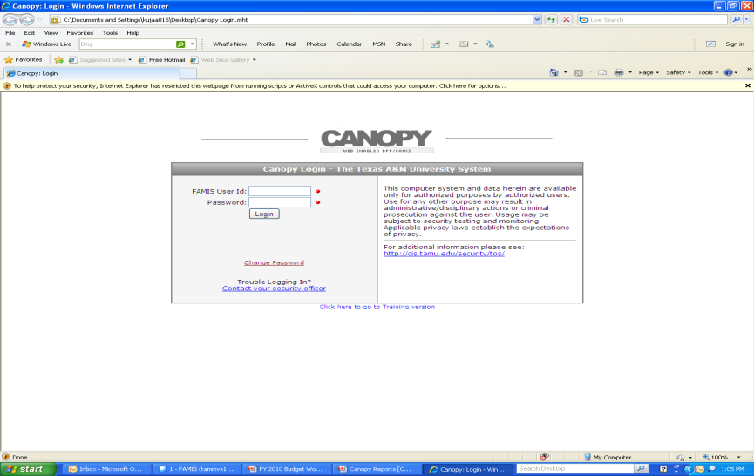
Downloading Monthly Statements is Excel or Adobe https://apps2.system.tamus.edu/canopytwo/login.aspx

Slide 11
Canopy Reports and Tips
https://canopy.tamus.edu/

Slide 12
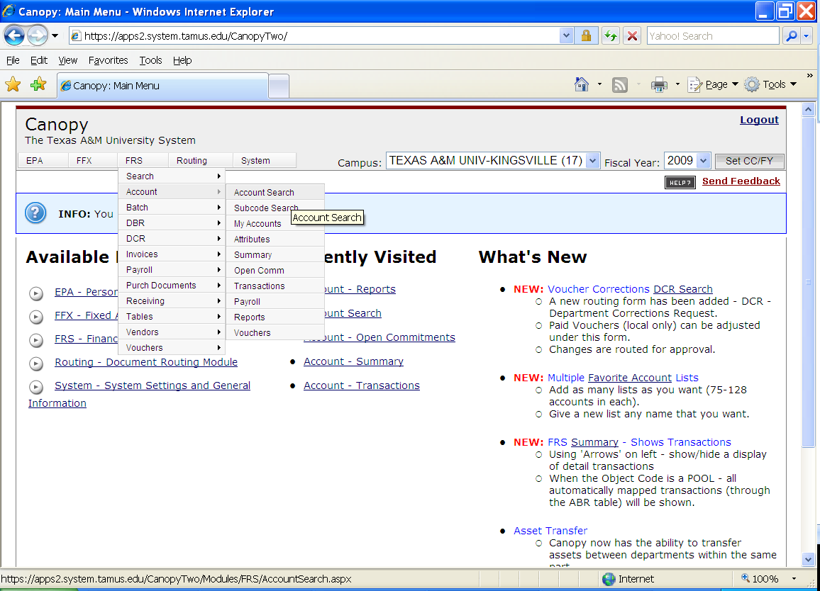
Without clicking, hold the cursor over the FRS tab.
A drop down box will appear.
Move the cursor over Account to Account Search, then click.

Slide 13
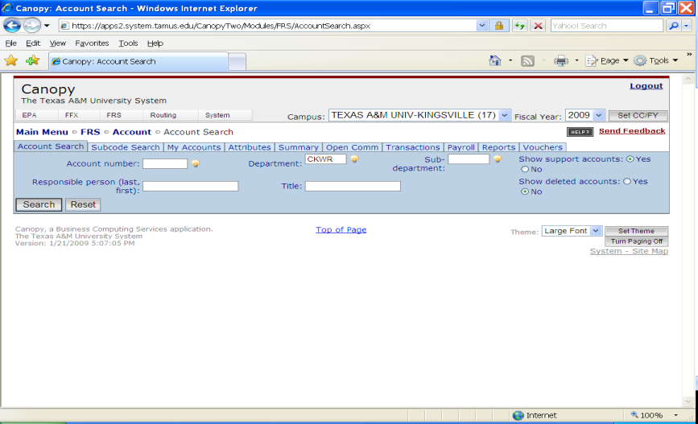
A new screen will open up.
There will be an option to select an account from the drop down menu or manually type in the account number.

Slide 14
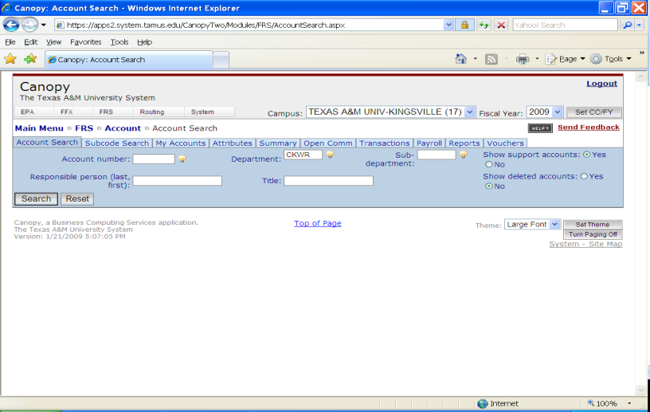
Another feature is Show Support Accounts. Select YES, then click the SEARCH box.

Slide 15
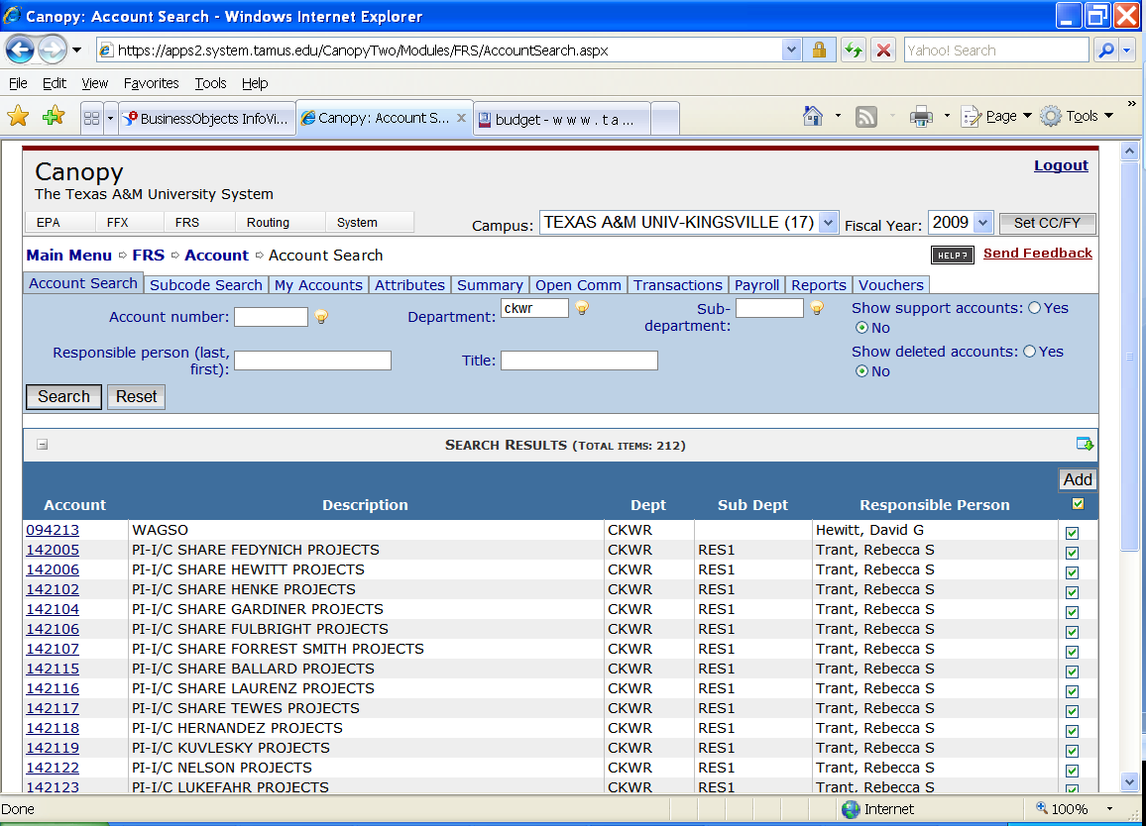
When the new screen opens, click on the box below Add.
This will select all of the accounts found within the search.
Otherwise, individually select the accounts needed then click on Add.

Slide 16
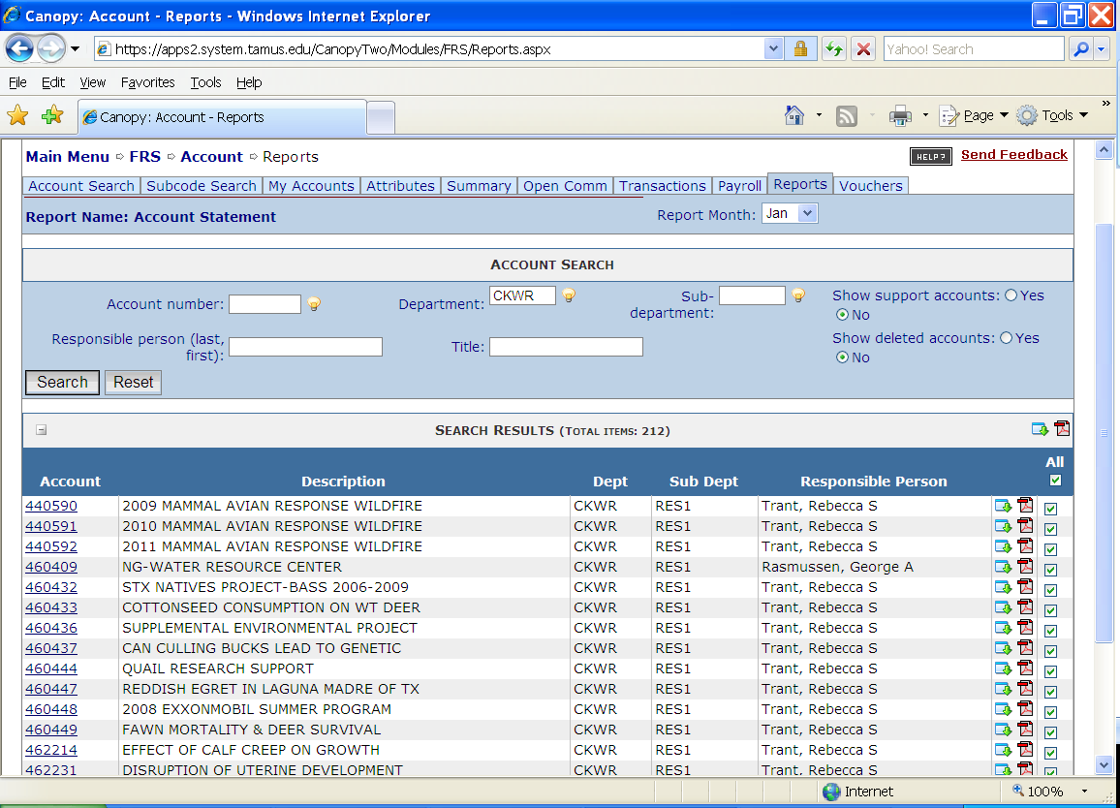
Next, click the ‘Reports’ tab.
Click on the box below All.
This will select all the accounts you chose within the search.

Slide 17
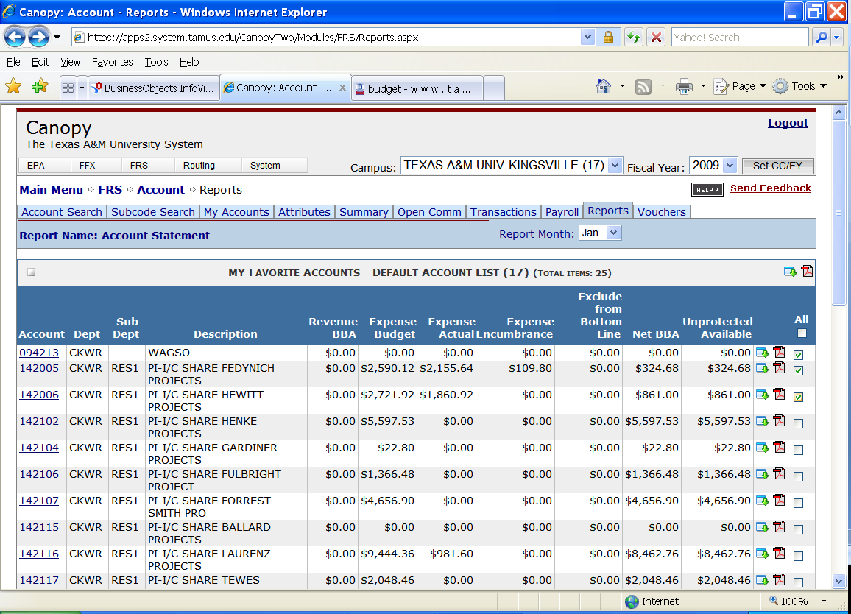
Or individually select the accounts you need and then click on Add

Slide 18
There are two icons above All. One representing Excel, the other PDF. Click on the type of file preferred.

Slide 19
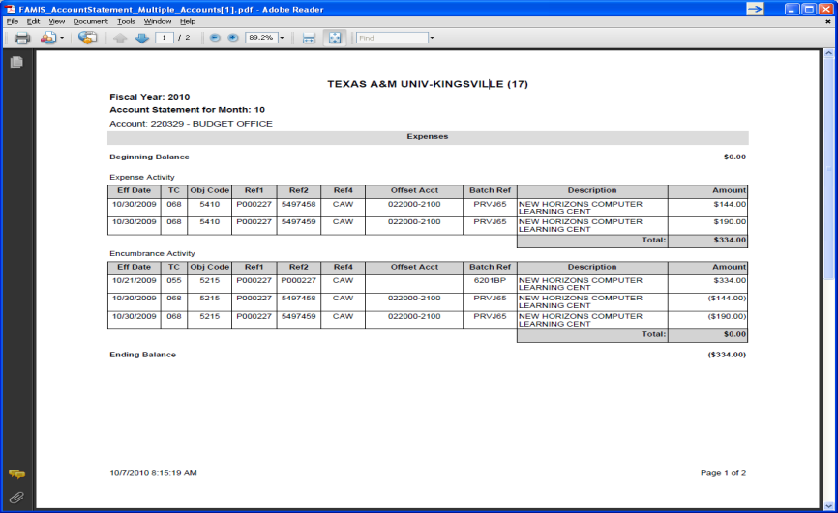
PDF version of a report

Slide 20
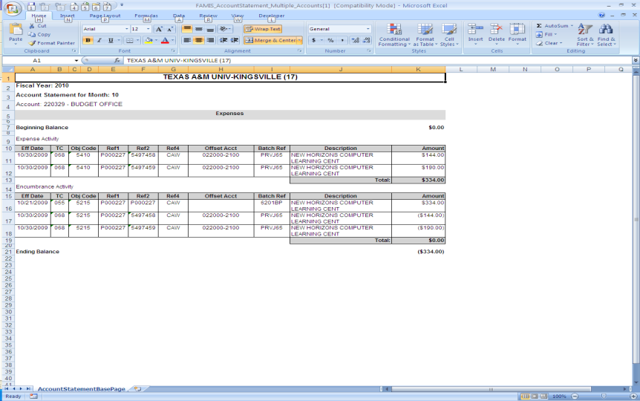
An Excel version of a report

Slide 21
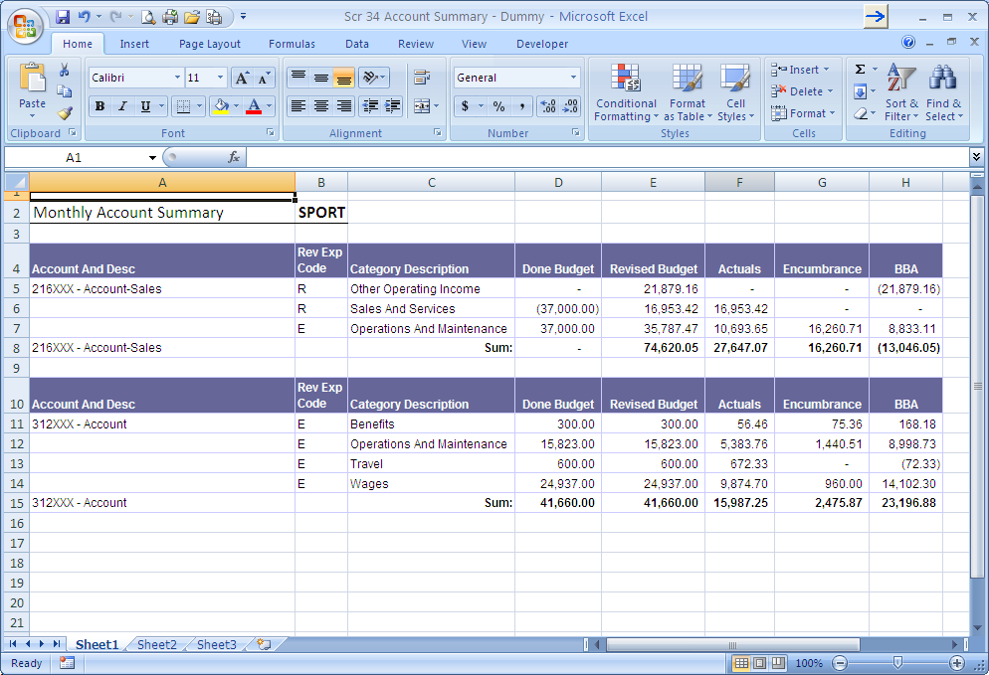
Monthly Account Summary
Revenue or Expense

Slide 22
What do all of these number mean?
Done Budget – The original amount of funding the account received for the current year.
Revised Budget – The current amount of funding the account received for the current year including any additions or reductions.
Actuals – The total of all expenditures charged to the account for the current year.
Encumbrance – The total of all purchase documents created but not yet paid.
BBA – Budget Balance available. The amount of funding available for the remainder of the current year. FORMULA = Budget – Actuals – Encumbrance.

Slide 23
University Service Fee

Slide 24
University Service Fee Values
Simplifies tuition and fee bills for students and parents.
Eliminates unexpected expenses related to the addition of the instructional enhancement fees to student bills.
Gives parents/students a set rate for planning four years of attendance.

Slide 25
University Service Fee
Eliminated Fees:
  Computer Use Fee
  Library Access Fee
  International Education Fee
  Transcript Fee
  ID Card Fee
Graduation Fee
Environmental Service Fee
Transportation & Safety Fee
Advising Fee
Instructional Enhancement Fee

Slide 26
University Service Fee
Fees that will not be eliminated:
  Athletic Fee
  Recreational Sports Fee
  Group Hospital Fee
  Student Services Fee
  Student Center Complex Fee

Slide 27
New Expense Accounts
ACCOUNT NAME | NEW ACCOUNT NUMBER | DEPARTMENT | OLD ACCOUNT NUMBER
USF ACADEMIC ADVISING OPERATING | 216200 | AVPS | 216525
USF ID CARD OPERATING | 216205 | AVPS | 216545
USF INTERNATIONAL ED OPERATING | 216210 | INTST | 216615
USF REGISTRAR OPERATING | 216215 | RGAD | 216705
USF ITECH OPERATING | 216220 | CISC | 217005
USF ITECH MAINT. CONTRACT RENEWALS | 216221 | CISC | 217004
USF DISTANCE LEARNING | 216222 | CISC | 217106
USF LIBRARY OPERATIONS | 216230 | LIBR | 218505
USF LIBRARY COLLECTIONS | 216231 | LIBR | 218510
USF SUSTAINABILITY OPERATIONS | 216240 | VPFA | 313005
USF TRANSPORTATION & SAFETY OPER | 216245 | VPFA | 313505
USF GRADUATION OPERATING | 216250 | ACAD | 316005
USF CLAS ENHANCEMENT | 216255-00001 | CLAS | 216301-(00001-00020)
USF CLAG ENHANCEMENT | 216256-00001 | CLAG | 216302- (00001-00004)
USF CLBA ENHANCEMENT | 216257 | CLBA | 216303
USF CLED ENHANCEMENT | 216258 | CLED | 216304
USF CLEN ENHANCEMENT | 216259-00001 | CLEN | 216305
USF AVPS ENHANCEMENT | 216260 | AVPS | 216306
USF DEBT SERVICE | 216297 | FISC
USF SALARY SAVINGS | 216298 | SSAV

Slide 28
New Payroll Forms

Slide 29
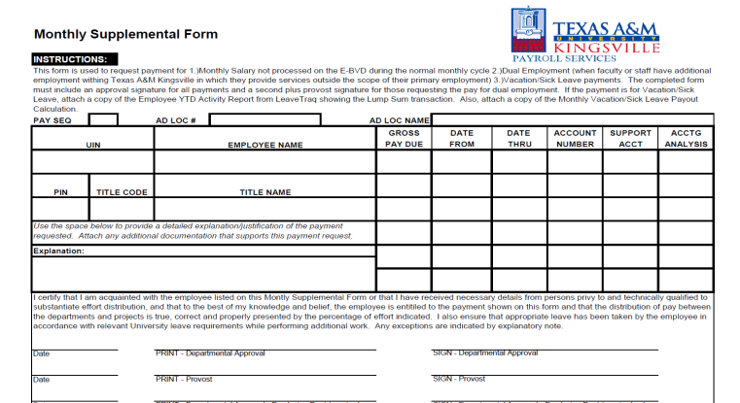

Monthly Supplemental Form
This form will ONLY be used for extra pay, overloads, and supplemental pay.

Slide 30
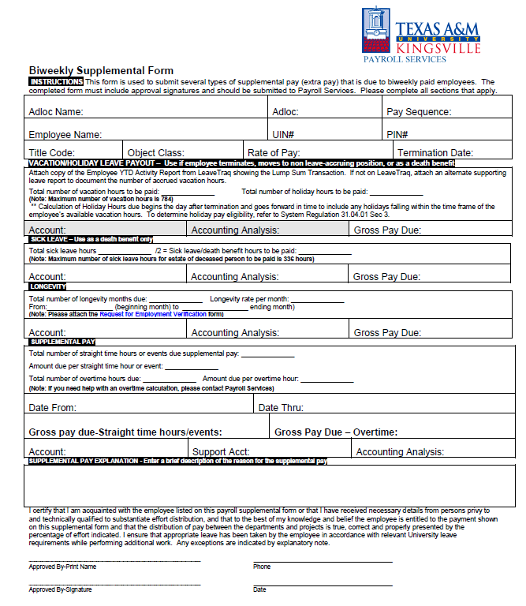
Biweekly Supplemental Form
This form will only be used for catching a student up with money that is owed to them.
Do NOT use this form as a means of Extra Pay for the student.

Slide 31
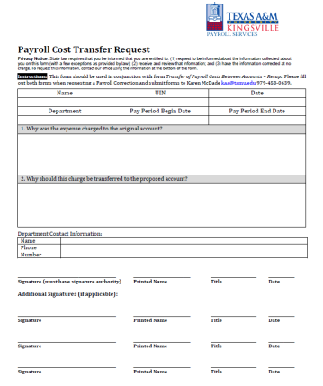
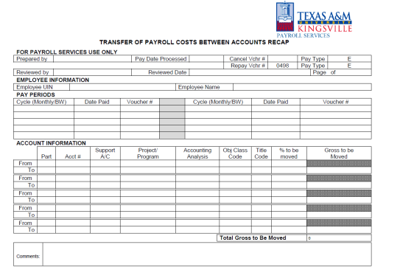
Fund Switch Forms

Slide 32
HELP!!!
Jennifer Alexander
Interim Director of Budget
Ext. 2793
Abel Morales Jr.
Budget Analyst
Ext. 3701
Please contact the Budget Department at budget@tamuk.edu for any questions or budget inquires.

