Slide 1

Org Leadership
2025-2026

Slide 2

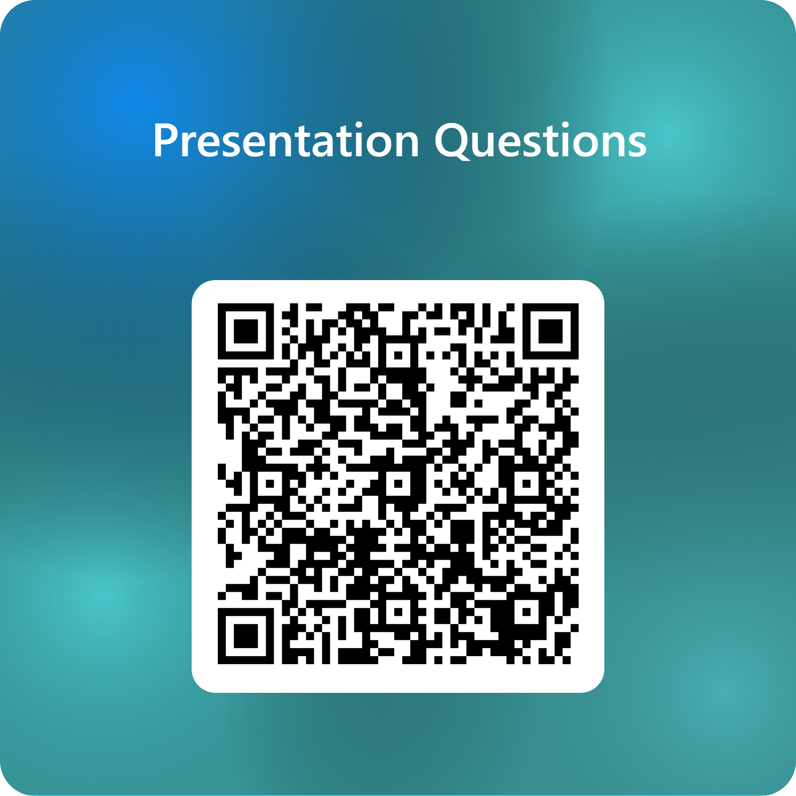
Questions?
Contact:
Office of Compliance
Lewis Hall, Suite 130
361-593-4758
You can use the QR
code to ask any
questions you have
as I go through the
presentation.

Slide 3
Reportable Incidents
Discrimination Reportable Incidents:
Race
Color
National Origin
Age
Religion
Sex
Pregnancy Status
Veteran Status
Disability (Physical/Mental)
Genetic Information
Related Retaliation
Discrimination based on sex includes:
Sexual Harassment
Sex-based Misconduct
Sexual Assault
Dating Violence
Domestic Violence
Stalking (Based on Sex)
Sexual Exploitation
Related Retaliation
Reports can be made that occurred on campus or off campus and can be made against an employee, student, or 3rd party reports.

Slide 4
Retaliation
Retaliatory action of any kind is prohibited when taken against anyone participating in a discrimination investigation, complaint, hearing or lawsuit. Such retaliatory action(s) will be regarded as a separate and distinct cause for complaint and possible disciplinary action, including dismissal and/or expulsion.
Pressuring someone to change their story or not report
Deleting text messages, emails, etc.
Lying to or misleading investigators during an interview
Intimidating or threatening someone who made a report
Singling someone out or indirectly punishing them during practice, work assignments, etc.
Directing others to treat someone differently

Slide 5
Mandated and CSA Reporting
All faculty and staff are mandated to report incidents of discrimination, Title IX, or Sex-based Misconduct
Only some employees have been designated as Campus Security Authorities and should report Clery and VAWA crimes to the Clery Coordinator when made known to them during work/CSA function.
Mandated reporting and CSA reporting are separate
Mandated Reporting
CSA Reporting
Tasha Clark
Office of Compliance
Lewis Hall, Suite 130
361-593-4758
TitleIX@tamuk.edu
Tasha.Clark@tamuk.edu
Paige de Vaudrecourt
University Police Department
Lewis Hall
361-593-2611
upd@tamuk.edu
Paige.deVaudrecourt@tamuk.edu

Slide 6
Where can you go to REPORT concerns?
Office of Compliance
  Lewis Hall, Suite 130
Deputy Title IX Coordinators
  Hanna Lantz – Athletics
  Kirsten Compary – Dean of Students
Police
  Jurisdiction where crime occurred
Advocacy (off campus resource)
  Purple Door
Mandated Reporters
  Staff
  Faculty
  University Police Department (Lewis Hall)
Confidential Reporters
  Counselors at Student Health and Wellness
Anonymous Reporting (Bottom of every TAMUK webpage)

Slide 7
RESOURCES
Mutual Orders of No Contact
Reporting to UPD
Counseling with Student Health and Wellness
Changes in On-campus Housing
Changes in Class Schedules
Changes in Work/Training/Practice Schedules
Communicating with Professors Regarding
  Absences
  Missed Course Work
Off Campus
  Reporting to KPD
  Transportation for SANE exam
  Advocacy
    Off-campus housing changes
    Protective Orders
  Legal Aid
    Off-campus housing changes
    Protective Orders
A formal complaint is not required to obtain supportive measures.

Slide 8
Complaint PROCEDURES
Make sure you report to Compliance before removing students from programs and activities.
FORMAL INVESTIGATION:
INFORMAL RESOLUTION:
Formal Complaint
Inquiry
Investigation Process
  Meetings
  Review
Preponderance of an Evidence Standard
Panel or Designated Administrator
Appeals
Formal Complaint
Voluntary Request and Approval of Parties
Parties Decide Outcomes
  Sanctions
  Non-Sanctions
Approval from University
Becomes the Resolution

Slide 9
Student Sanctions
If there is a finding of responsibility:
Sexual Assault
Suspension
Expulsion
Sexual Exploitation
Probation
Suspension
Expulsion
Harassment
Warning
Probation
Suspension
Expulsion
Relationship Violence
Suspension
Expulsion
Stalking based on sex
Warning
Probation
Suspension
Expulsion
Retaliation
Suspension
Expulsion
Depending on the allegation and sanction, students could lose eligibility for institutional scholarships and ability to participate in athletics/other organizations. This is after a finding of responsibility.

Slide 10
Sexual Harassment
Stalking
Sexually suggestive gestures
Inappropriate teaching or jokes
Unwelcome touching, pinching, patting
Unwelcome attempts to kiss
Pressure for dates
Inappropriate remarks of a sexual nature
Graffiti or illustrations of a sexual nature
Ignoring someone’s sex/relationship boundaries
Two or more incidents
Substantial Emotional Distress, or
Belief that someone’s safety is being threatened.
Can include:
Reports occurring at an off-campus location or another school
Reports occurring within a current relationship
Reports involving a third-party
Reports involving consent to one sexual activity, but not to another

Slide 11
What does Consent look like?

Slide 12


Slide 13
Consent
CLEAR, WORDS, and ACTIONS that creates a MUTUAL AGREEMENT regarding the sexual activity that will take place.
Does NOT rely on:
Threats
Pressure
Coercion
The way someone is dressed
Flirtatious behavior
Prior encounters
Sexual History
Sexual Assault Myths:
Requires physical violence
Only committed by strangers
Only committed by men
Does not happen in LGBTQI+ relationships
*Look for an ENTHUSIASTIC partner.

Slide 14
What Consent Sounds Like
Starting the conversation…
What are you into?
I’m really enjoying our time together, do you mind if I…?
Do you want to…?
Raise your hand if you wanna go have sex!”
“Where do you want to be touched?”
“How can I make you feel good?”
“What do you want to do together tonight?”
“What words do you like to hear about yourself and your body?”
“What do you like in bed?”
Saying No to one thing…
Ooh that’s a three-month-in level thing for me…
I’m not really feeling that, but maybe we can do this?
Hang on, I want to take a break for a second.
I’m really not into that, but I do like…
That makes me uncomfortable, but what if we…
http://thesaltcollective.org/make-consent-sexy/

Slide 15
Scenario
A is in the locker room with B.
A asks B if they want to see something on their phone.
A shows B a naked picture of someone they went out with.
A mentions they took the picture during a sexual encounter.
B asks A for the picture and A share’s the picture.

Slide 16
Alcohol and Consent
Incapacity - A state in which a person, due to a disability, the use of alcohol or drugs, being asleep, or for any other reason, is not capable of making rational decisions about consent to sexual activity and recognizing the consequences of their decision.
Slurred Speech
Vomiting
Can’t walk without help
Odor of alcohol
Combativeness
Emotional Volatility
Confusion of basic facts (day of the week, etc.)
Passing out
Can’t focus on surroundings
*It DOES NOT matter who initiates sexual activity.

Slide 17
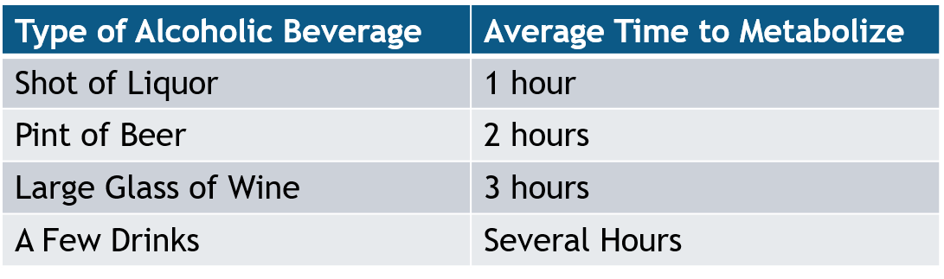
Drinking Facts
Other factors that you may not know:
History of Drinking
Weight
Age
Drinking on an Empty Stomach
Amount of Time the Drinks were Consumed

Slide 18
DRINKING FACTS
What is the number one drug found in incidents of sexual assault?
  Alcohol
How many standard drinks in one red-solo cup of trash can punch?
  On average 5
How long do you have to obtain a SANE exam if you think you’ve been drugged?
  On average 48 hours

Slide 19
What does a healthy relationship look like?

Slide 20
Relationships
Unhealthy
Healthy
Intensity
Possessiveness
Manipulation
Isolation
Sabotage
Belittling
Guilting
Volatility
Deflecting Responsibility
Betrayal
Comfortable Pace
Trust
Honesty
Independence
Respect
Equality
Kindness
Taking Responsibility
Healthy Conflict
Fun

Slide 22
Safety Tips: Dating
Communication is key when setting up boundaries with partners. With online and in-person dating there are also additional safety tips that you can take:
Control information
Public Location
Transportation
Share location w/friends
Have a check-in
Pay attention to Red flags
Can communicate boundaries before and during the date

Slide 23
Scenario
A and B met during the first few weeks of school.
A asked B for B’s Instagram info.
B seemed to hesitate but sent it anyway.
After a couple of weeks, A asked B out and B said no.
A started sending DMs to B asking why they weren’t interested. B asked A to stop contacting them.
A doesn’t stop.
B blocked A, so A decided to drive around B’s apartment and find them on campus.
B started receiving gifts at their work.

Slide 24
Safety Planning
During a break-up there can be safety issues if the relationship was unhealthy. Safety planning may involve:
Have a phone charged
Create code words
Unpair communication
Protective Orders/NCOs
Walk with a group
Change routine
Think about exit routes
Online presence
Location drop-offs
Advocacy/Legal Aid

Slide 25
Bystander INTERVENTION
DIRECT
  Tell Someone to STOP
DELEGATE
  Seek HELP from friends or authority figures
  REC Employees can be delegates
DISTRACT
  INTERRUPT the situation to SEPARATE and CHECK-IN without causing attention to the situation
If there’s a Safety Issue…CALL 911

Slide 26
Creating a Culture of Respect
Discuss behavioral expectations for group members
Model behavioral expectations for group members
Reinforce behavioral expectations for group members
  May use bystander intervention
Report concerning behaviors

Slide 27
Pregnancy / Parenting
Students can be directed to offices below. Assistance may include:
Alternative Arrangements for Medically Necessary Absences/Accommodations
Temporary Leave
Cannot be Told They Can’t Participate
Pregnancy Contact
Parenting Contact
Tasha Clark
Office of Compliance
Lewis Hall, Suite 130
361-593-4758
TitleIX@tamuk.edu
Tasha.Clark@tamuk.edu
Jo Elda Alaniz
Student Health and Wellness
1210 N. Retama St.
361-593-2382
Jo.Alaniz@tamuk.edu

Slide 28
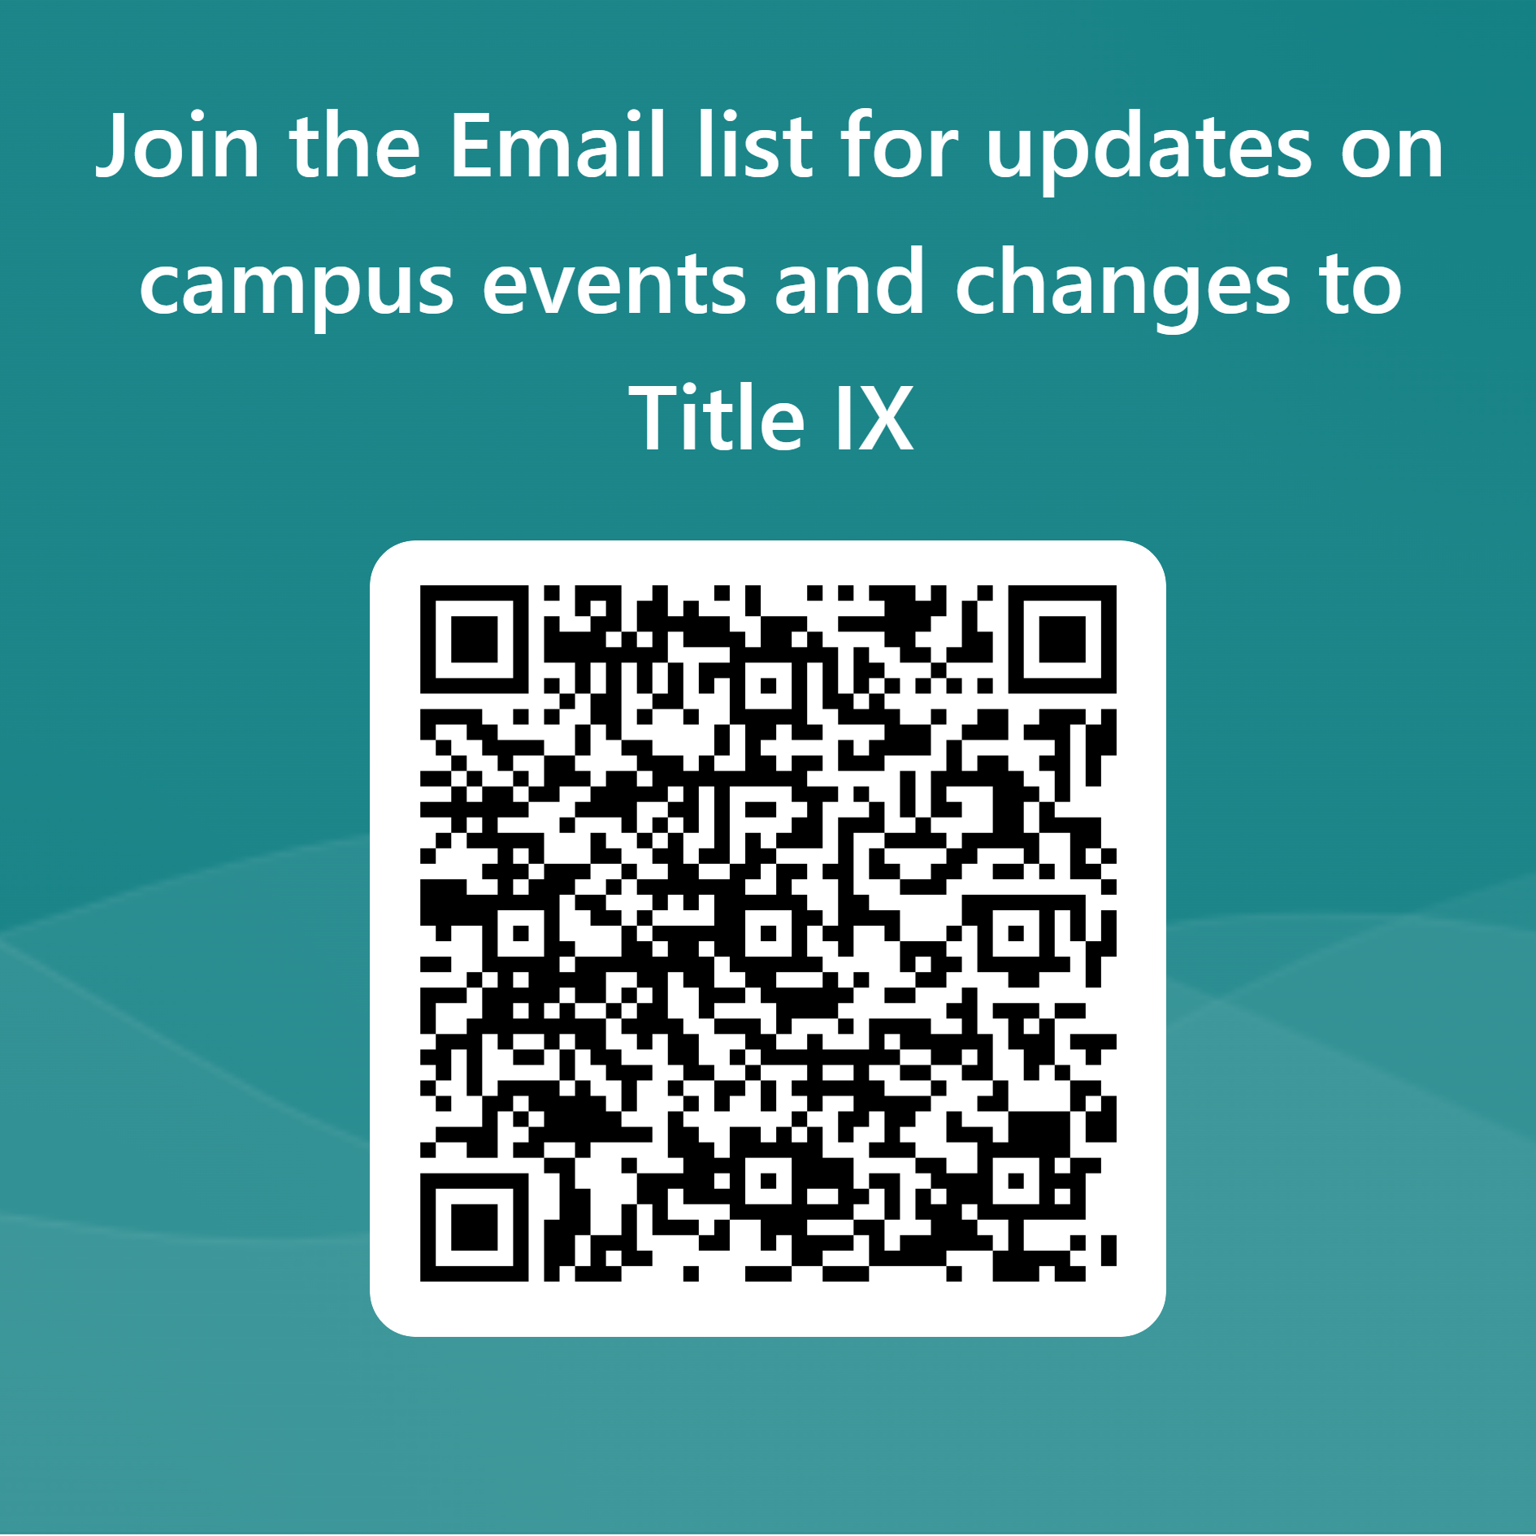
Questions?

